Slide 1
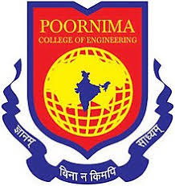
Poornima College of Engineering B. Tech. III Year (VI Semester) Session: 2021-22
Project Title: Google Lens Clone using Image Recognition
Group Number: 6CSB7
Submitted By:
1. Rishi Goyal, PCE19CS140, 19EPCCS140
2. Ridhvi Kulshrestha, PCE19CS139, 19EPCCS139
3. Ishan Jain, PCE19CS075, 19EPCCS081
4. Priyansh Sharma, PCE19CS130, 19EPCCS130
5. Richa Garg, PCE19CS138, 19EPCCS138
Project Guide: Ms. Sonam Gaur
Academic Year: 2021-2022
Department of Computer Engineering, PCE, Jaipur

Slide 2
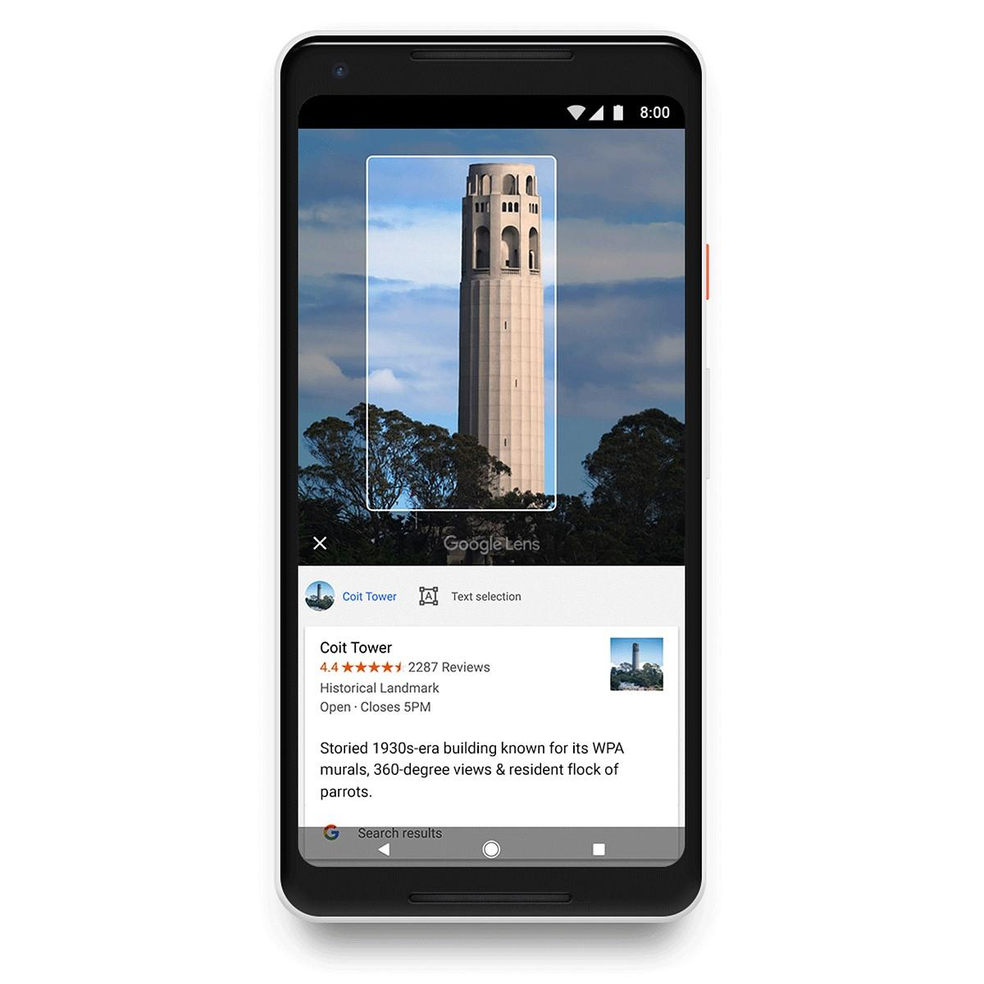
Abstract
Smartphones are more advanced than ever. They’re filled with plenty of features, like the front- and rear-facing cameras, pulse rate monitors, fingerprint screen lock, and access to apps galore.
The objective of our project is to develop a user-friendly android mobile application that will help to understand and interact with what’s in our camera’s viewfinder.
Object Recognition - Identifying the content from a picture. It very well may be utilized for photographs of signs, names, labels, etc. It can be useful for many cases like detecting objects from an image.

Slide 3
Taking a picture, and identifying substances it contains, for example, objects, creatures, natural products, exercises and that's just the beginning.
Face Detection - Not to be mistaken for face acknowledgment, which can perceive who is the individual in the picture or realizing that we see a similar individual on numerous Photographs.
Expected Outcome To design and develop a smart user-friendly application that will help a user to recognize text from an image, copy that text & translate the text into any language. Identifying objects from an image. Identify key facial features.

Slide 4
Literature Review
Google Lens is an AI-powered technology that uses your smartphone camera and deep machine learning to not only detect an object in front of the camera lens, but understand it and offer actions such as scanning, translation, shopping, and more.
Lens was one of Google's biggest announcements back in 2017, and a Google Pixel exclusive feature when that phone launched. Since then, Google Lens has come to most Android devices.
Google Lens enables you to point your phone at something, such as a specific flower, and then ask Google Assistant what the object you're pointing at is. You'll not only be told the answer, but you'll get suggestions based on the object, like nearby florists, in the case of a flower.

Slide 5
Problem Statement & Objective
In our day-to-day life, we come across various products that fascinates us. There are various queries that like the price of that item.
This application solves those problems by its camera search feature.
We can capture the image of the product and it will search for that particular product in the database.
The camera uses Image Recognition and Machine Learning to process the image and search for similar results in the database.

Slide 6
Design Approach
Buy Product
click
List of Products
Product Detail
Additional feature of Button for scanning the items
Rating Feature
Shopping Cart
Continue Shopping
Checkout
Enter Coupon Code

Slide 7
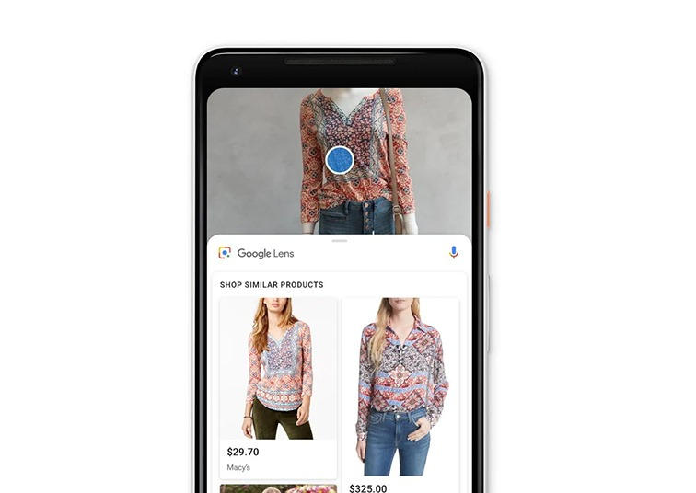
Design of Solution
Image Recognition Feature in the Shopping App provides various advantages
Better product recommendations
Faster searches
Services of a virtual stylist
Ability to create new sales channels
Tap-to-buy – possibility to shop from videos

Slide 8
Results & Discussion
Whenever we are using classification algorithms, the result is in the terms of accuracy.
Normally, the accuracy is varying from algorithm to algorithm and datasets to datasets as well as tool to tool. So, Google Lens can be the best Image classifier.
Google Lens App is download from Google Play Store in Samsung J7 and experiments were conducted.
While using Google Lens for image classification, we found different categories of results.

Slide 9
It is perfectly classified the images which are captured via Google Lens in mobile.
For example, mangoes and coconut images are captured and the results are flawlessly matched
Accordingly, Google Lens advantages and disadvantages are described with the few discriminating examples which were fronting in analysis.
For the above example, the drawbacks of Google Lens can be improved by its feature selection algorithms and training of classification algorithms.

Slide 10
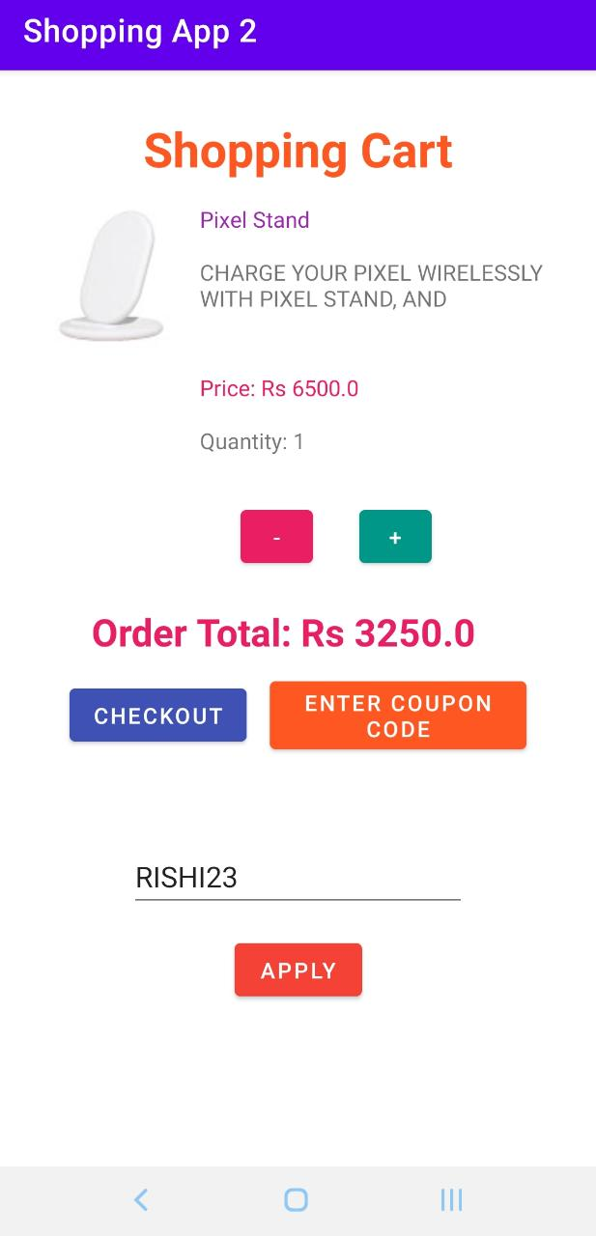
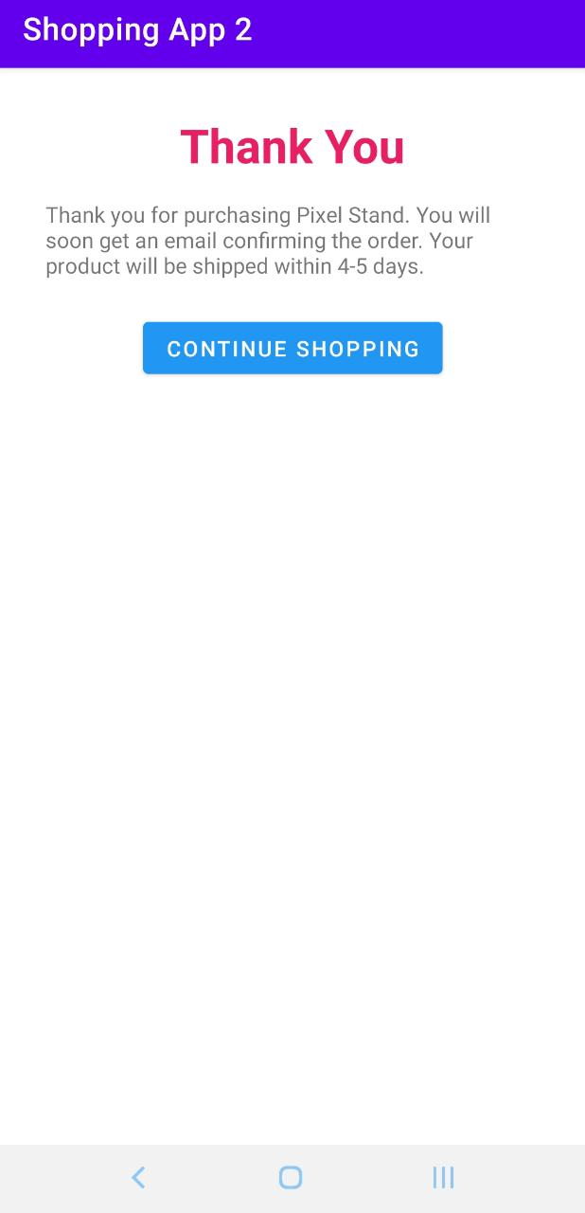

Experimental Setup & Variations

Slide 11
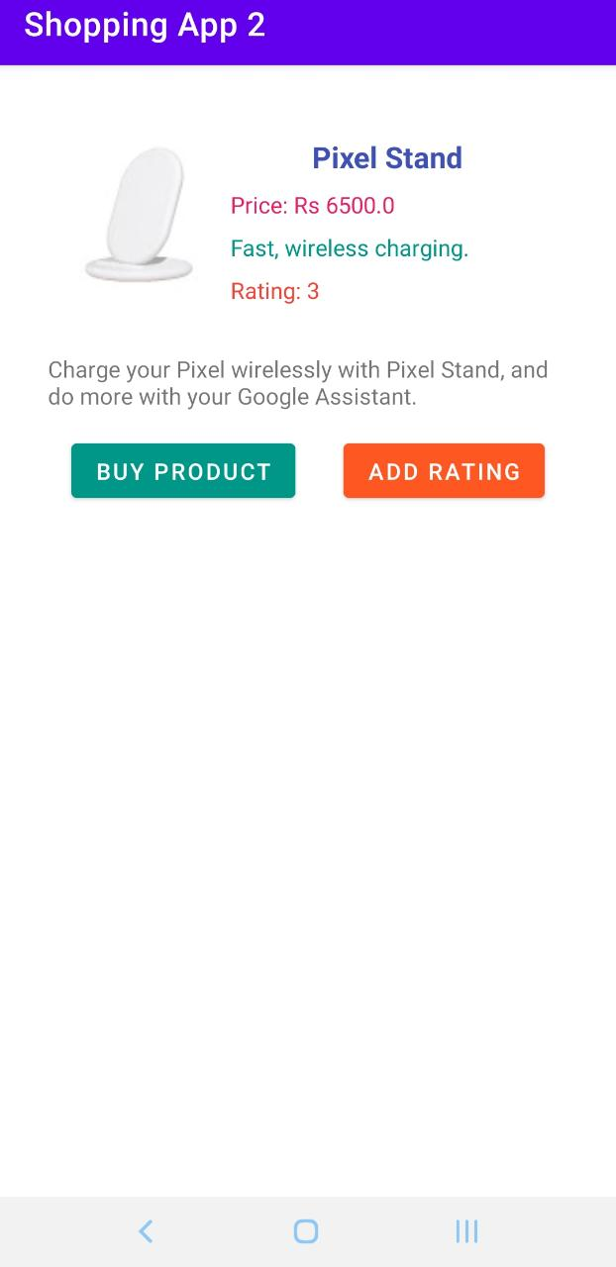
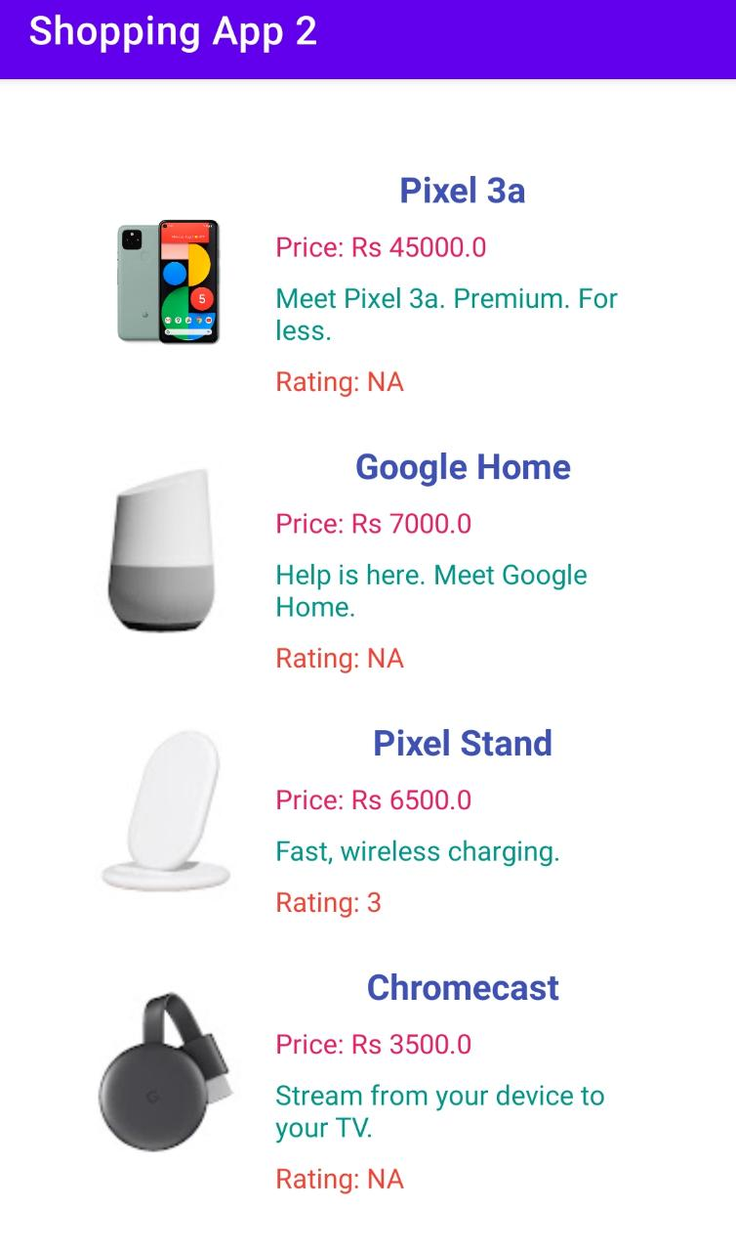

Slide 12
Conclusion and Future Scope
Google announced Google Lens, with which Google can "understand what we're looking at and help us take action,"
CEO Sundar Pichai said. "We can give you the right information in a meaningful way."
New Google's Lens enables users to search with their phone's camera. Its augmented reality further than photo filters.
The Google Lens can achieve relatively a good classification accuracy when compared to any other available features.

Slide 13
It is a hope that the image processing task in this study will be further enhanced, or new methods will be applied to obtain better representation of the feature extraction.
In future Google Lens might tip our world over so that we start using Google Assistant ten times a day, every day.
The experimental results have shown that using combined features outperforms any individual feature. It is hoped that the image processing task in this study will be further enhanced, or new methods will be applied to obtain better representation of the feature extraction.

Slide 14
References
https://dspace.mit.edu/handle/1721.1/122989: An Educational Approach to Machine Learning with Mobile Applications by Kevin Zhu Submitted to the Department of Electrical Engineering and Computer Science.
https://www.spiedigitallibrary.org/conference-proceedings-of-spie/10993/109930A/Deep-learning-on-mobile-devices-a-review/10.1117/12.2518469.short?SSO=1:Deep Learning on Mobile Devices – A Review by Yunbin Deng.
https://link.springer.com/article/10.1007/s11036-020-01650-z: Mobile Data Science and Intelligent Apps: Concepts, AI-Based Modelling and Research Directions by Iqbal H. Sarker published on 14th September 2020.

Slide 15
https://www.learntechlib.org/p/218010/: Mobile Applications for Diabetes Self-Care and Approach to Machine Learning by Denis Cedeno-Moreno
https://ceur-ws.org/Vol-2547/: The Google Lens analysing quality: an analysis of the possibility to use in the educational process, Viktor B. Shapovalov, National Center “Junior Academy of Sciences of Ukraine
https://www.researchgate.net/publication/336273452_Towards_Image_Classification_with_Machine_Learning_Methodologies_for_Smartphones: Lili Zhu and Petros Spachos, School of Engineering, University of Guelph, Guelph, ON N1G 2W1, Canada; lzhu03@uoguelph.ca

Slide 16


